Slide 1
Chapter 9
Uniprocessor Scheduling

Slide 2
Aim of Scheduling
Assign processes to be executed by the processor(s) to meet system objectives:
Response time
Throughput (processes completed rate)
Processor efficiency

Slide 3
Types of Scheduling
Long-term
Medium-term
Short-term

Slide 4
Long-Term Scheduling
Determines which programs are admitted to the system for processing
A job or user program becomes a process and added to the queue for the short-term scheduler
Controls the degree of multiprogramming
More processes, smaller percentage of time each process is executed

Slide 5
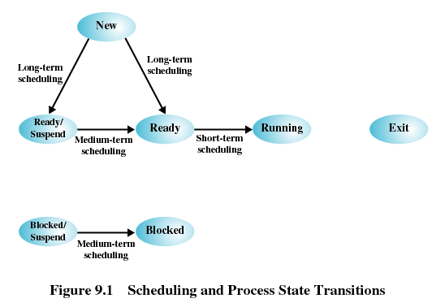
Types of Scheduling

Slide 6
Medium-Term Scheduling
Part of the swapping function
Based on the need to manage the degree of multiprogramming

Slide 7
Short-Term Scheduling
Known as the dispatcher
Executes most frequently
Invoked when an event occurs
Clock interrupts
I/O interrupts
Operating system calls
Signals

Slide 8
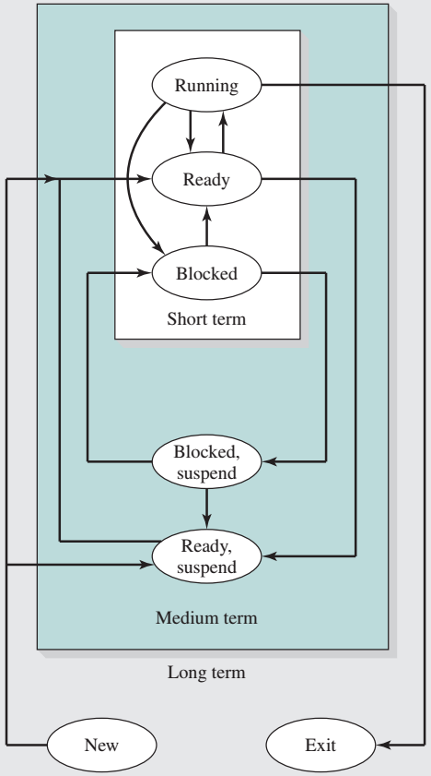
Scheduling

Slide 9
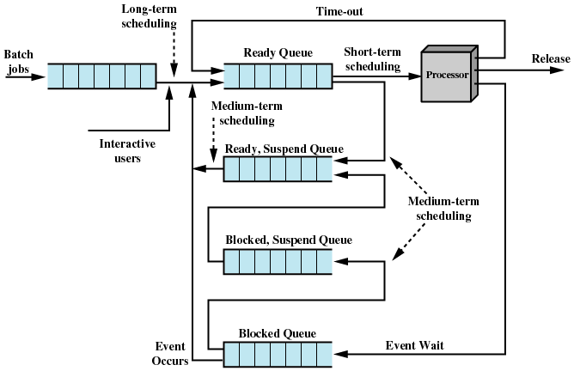
Scheduling

Slide 10
Short-Term Scheduling Criteria
User-oriented (system behavior perceived by user)
Response Time
Elapsed time between the submission of a request until there is output.
System-oriented
Effective and efficient utilization of the processor
Performance-related
Quantitative
Measurable such as response time and throughput

Slide 11
Priorities
Scheduler will always choose a process of higher priority over one of lower priority
Have multiple ready queues to represent each level of priority
Lower-priority may suffer starvation
Allow a process to change its priority based on its age or execution history

Slide 12
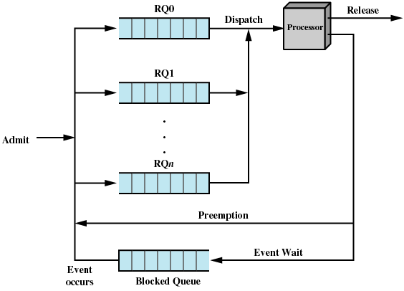
Priorities

Slide 13
Decision Mode
Nonpreemptive
Once a process is in the running state, it will continue until it terminates or blocks itself for I/O
Preemptive
Currently running process may be interrupted and moved to the Ready state by the operating system
Allows for better service since any one process cannot monopolize the processor for very long
Greater overhead

Slide 14
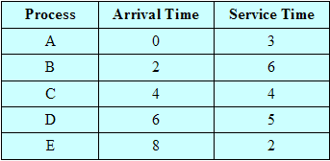
Process Scheduling Example

Slide 15
First-Come-First-Served (FCFS)
Each process joins the Ready queue
When the current process ceases to execute, the oldest process in the Ready queue is selected
A short process may have to wait a very long time before it can execute
Favours CPU-bound processes
I/O processes have to wait until CPU-bound process completes

Slide 16
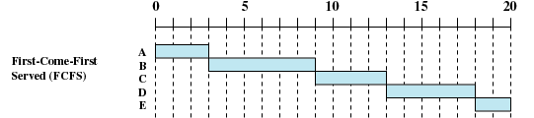
First-Come-First-Served (FCFS)

Slide 17
First-Come-First-Served (FCFS)
Turnaround time – total time that item spend in the system (waiting time plus service time)
Process | Arrival Time | Service Time | Start Time | Finish Time | TAT (T_{r})
W | 0 | 1 | 0 | 1 | 1
X | 1 | 100 | 1 | 101 | 100
Y | 2 | 1 | 101 | 102 | 100
Z | 3 | 100 | 102 | 202 | 199

Slide 18
Round Robin
Uses preemption based on a clock
An amount of time is determined that allows each process to use the processor for that length of time
Clock interrupt is generated at periodic intervals
When an interrupt occurs, the currently running process is placed in the read queue
Next ready job is selected
Known as time slicing

Slide 19


Round Robin

Slide 20
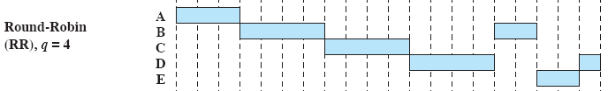
Round Robin

Slide 21
Shortest Process Next
Non preemptive policy
Process with shortest expected processing time is selected next
Short process jumps ahead of longer processes
If estimated time for process not correct, the operating system may abort it
Possibility of starvation for longer processes

Slide 22


Shortest Process Next

Slide 23

Shortest Remaining Time
Preemptive version of shortest process next policy
Must estimate processing time

Slide 24

Highest Response Ratio Next (HRRN)
When the current process completes or is blocked, choose next process with the greatest ratio (minimum is 1.0)

Slide 25
Example
Round robin, with time quantum of 3
Highest Respond Ratio Next
Process | Arrival Time | Service Time
A | 7 | 2
B | 5 | 5
C | 0 | 4
D | 2 | 6
E | 6 | 5

Slide 26
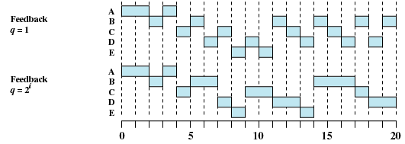
Feedback Scheduling
Penalize jobs that have been running longer
Don’t know remaining time process needs to execute
A process from RQ_{i} is allowed to execute 2i time units

Slide 27
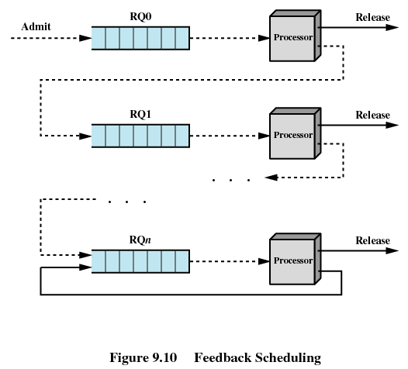
Feedback Scheduling

Slide 28
Fair-Share Scheduling (Multiuser System)
User’s application runs as a collection of processes (threads)
User is concerned about the performance of the application
Need to make scheduling decisions based on process sets

Slide 29
Fair-Share Scheduling (Multiuser System)
For process j in group k:
CPU_{j}(i) = measure of processor utilization by process j through interval i
GCPU_{k}(i) = measure of processor utilization by group k through interval i
W_{k} = weighting assigned to group k

Slide 30
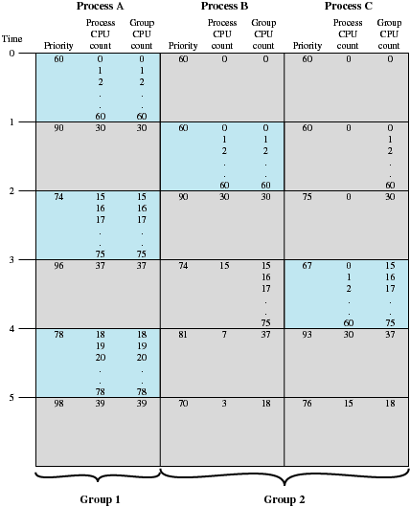
Fair-Share Scheduling (Multiuser System)
Base_{j} = 60
W_{k} = 0.5

